Slide 1

Final Project Big Data Case Study in Social Media
Del Pino Ruiz, Vicente Rubén
csci e63 Big Data Analytics, 2014
Harvard Extension School
Professor: Zoran B. Djordjević

Slide 2
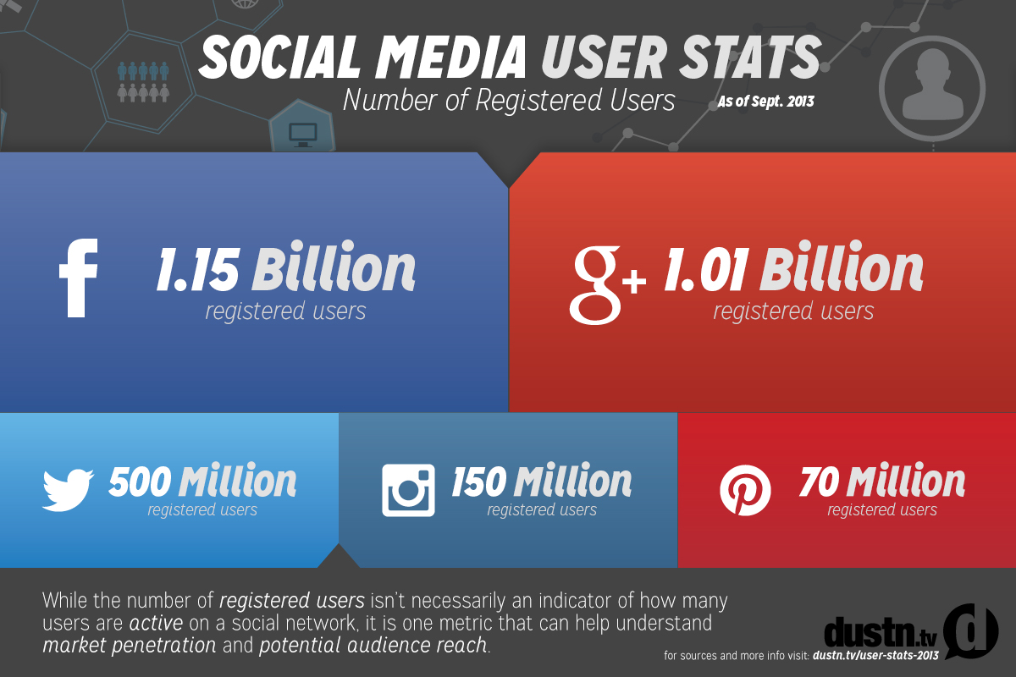
Social Media
Social Networks are increasing their number of users day by day.
This fact makes social networks a good place for getting a better insight about people social habits.

Slide 3
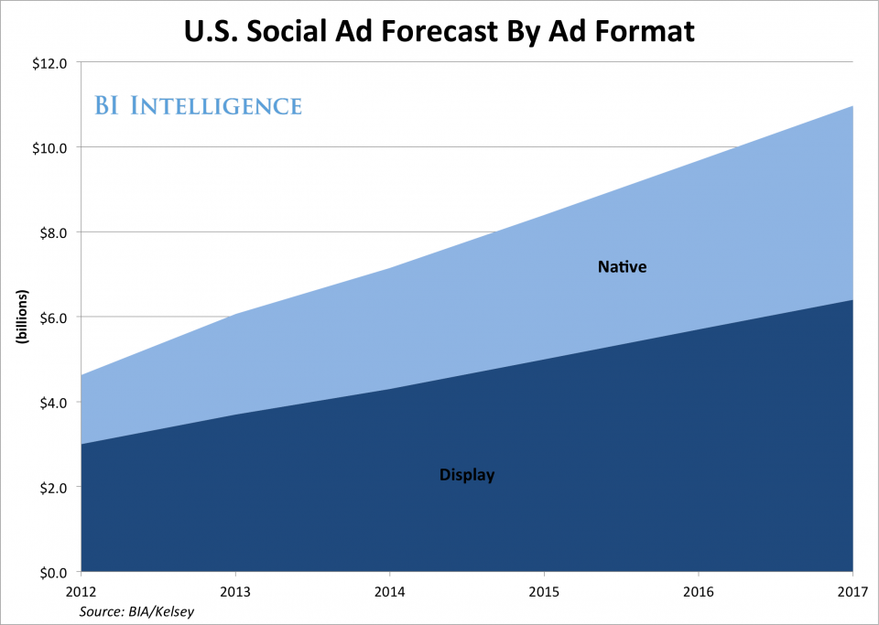
Advertising in Social Media
Reach specific groups of the population.
Get a better feedback of advertising.

Slide 4
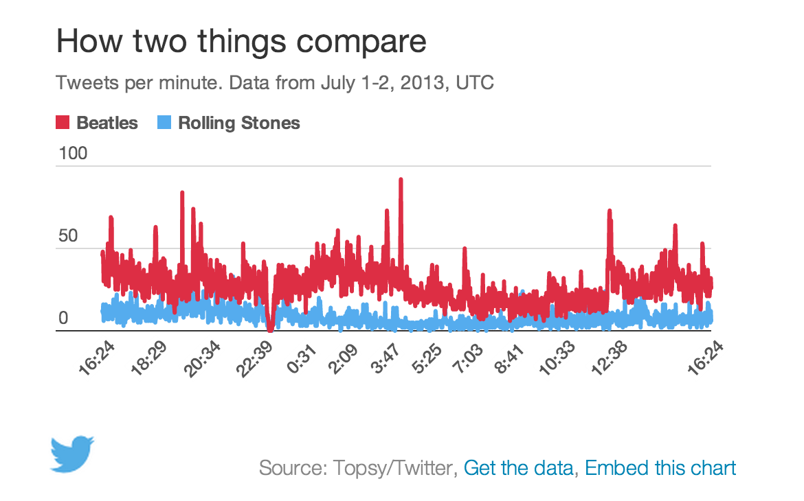
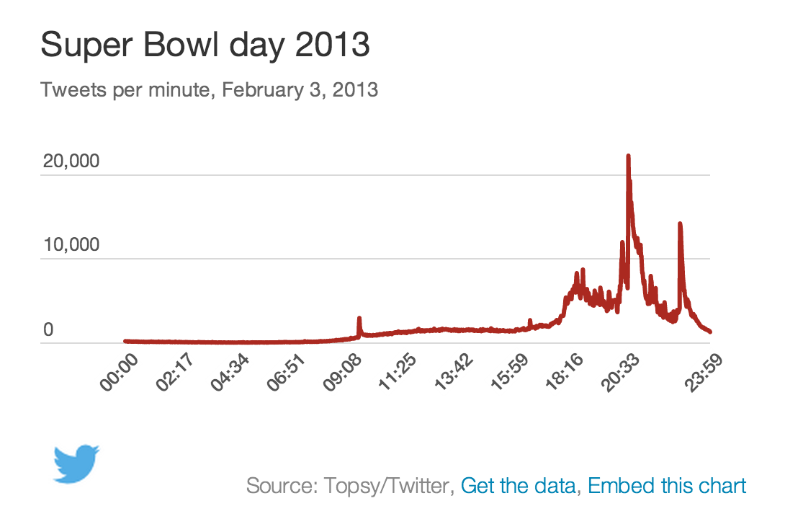
Measure engagement
How measure the engagement?
What is the data that can tell you how engaged your audience is on a Social Network?
Mentions per minute
Mentions per second
Followers
Sentiment

Slide 5
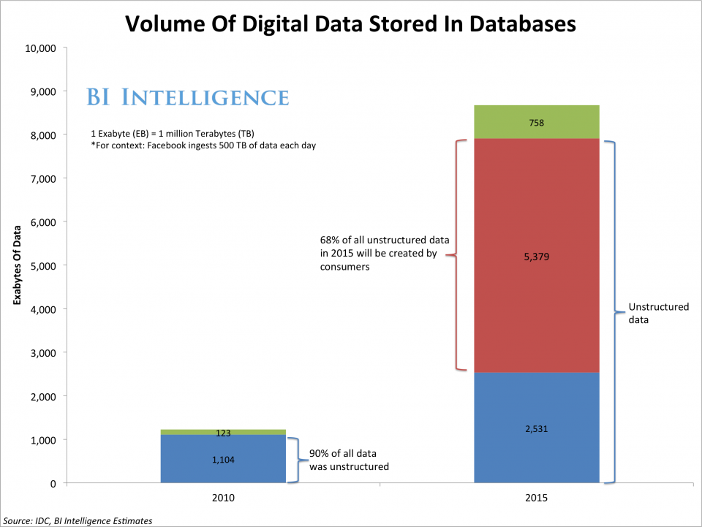
Data generated in Internet
Every second an endless stream of data is generated in Internet.
Social Networks record every aspect of our behavior in them: likes, friends, birthdays, relationships, trends…

Slide 6

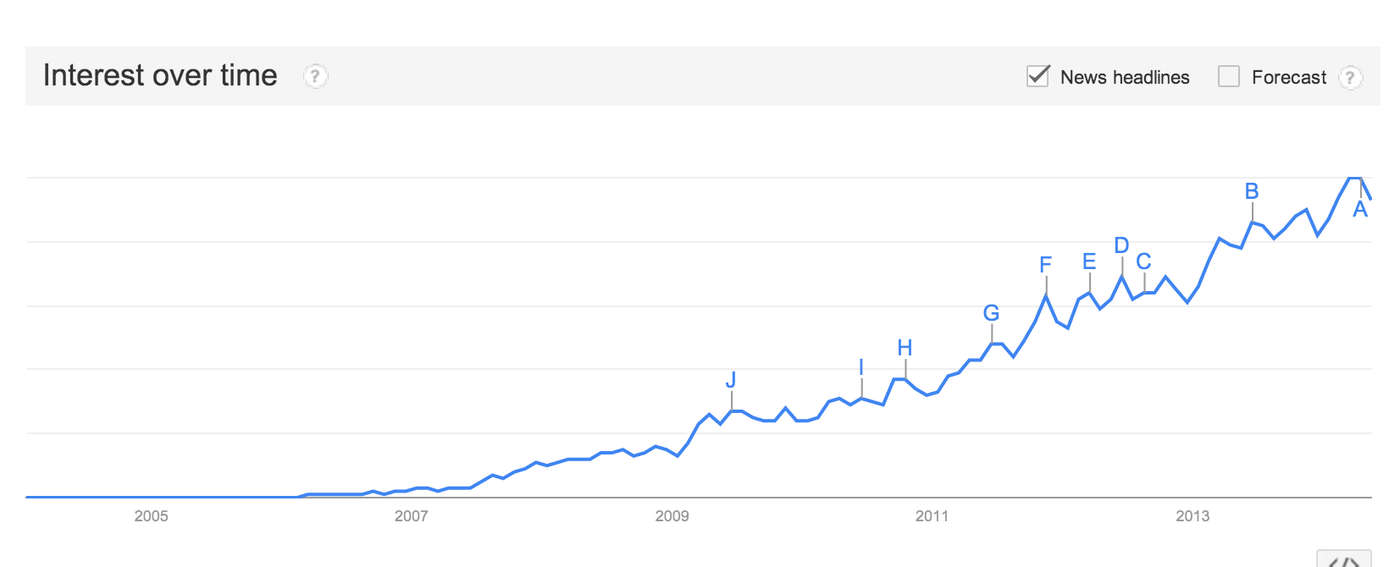
Hadoop
Apache Hadoop is an open-source software framework for storage and large-scale processing of data-sets on cluster of commodity hardware.
More and more people is interested and using Hadoop everyday.

Slide 7
Hadoop (II)
With the use of Hadoop is possible to analyze data generated in Internet.
This data that seemed to be impossible to analyze, now is a feasible task using Hadoop.

Slide 8
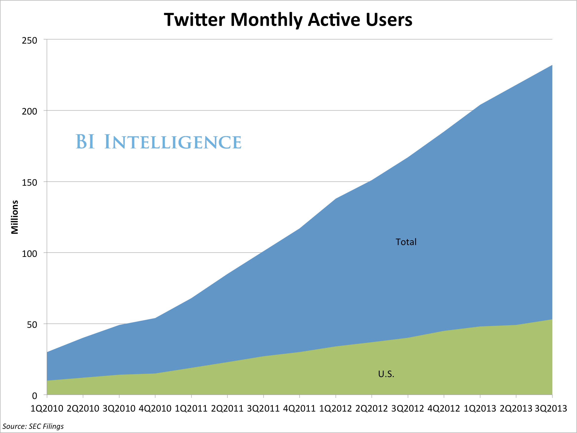
Twitter
Twitter is an online social networking and microblogging service that enables users to send and read short 140-character text messages, called “tweets”.

Slide 9
Movie Trender
The goal of this project is to analyze in near real time information from Twitter related to movies.
This information will help me to see and compare relevance between search terms.
The movies searched for the demo are:
The amazing Spider-Man 2
The other woman
Godzilla
X-Men: Days of Future Past
Transcendence
Noah
Maleficient
Edge of tomorrow
Blended

Slide 10
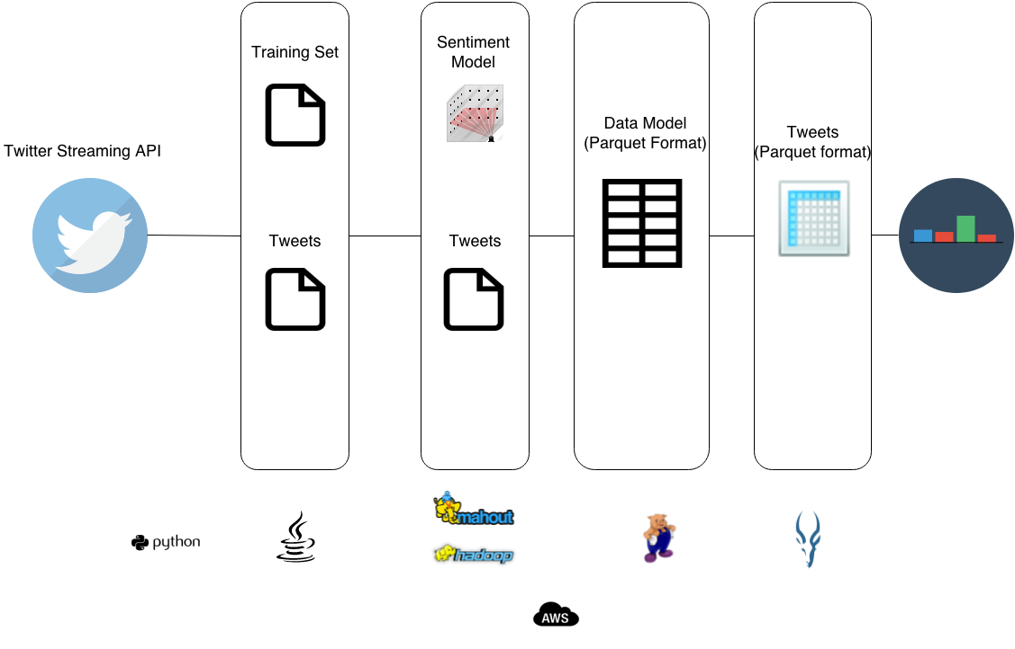
Movie Trender (II)
Design

Slide 11
Movie Trender (III)
Technologies used:
Java and Python.
AWS
Hadoop HDFS
PIG
Mahout
Impala + Parquet

Slide 12

MT- AWS
Amazon Web Services is a collection of remote computing services that together make up a cloud computing platform.
Components used:
Elastic MapReduce
S3 (Simple Storage Service)

Slide 13

MT- PIG
Apache Pig is a platform for analyzing large data sets that consists of a high-level language for expressing data analysis programs.
Pig is used in Movie Trender for moving data and storing them as a Parquet format.

Slide 14
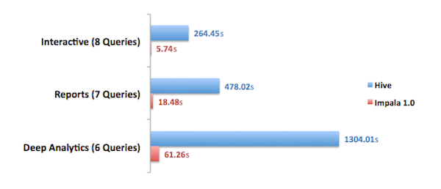
MT- Impala and Parquet
Impala has been created by Cloudera inspired on Google’s Dremel bringing real-time, ad hoc query capability to Apache Hadoop.
Parquet is built from the ground up with complex nested data structures in mind, and uses the repetition/definition level approach to encoding such data structures, as popularized by Google Dremel.
Cloudera benchmarks show Impala + Parquet 100x times faster than Hive.

Slide 15
MT- Analyze data in near real-time
Analyzing the data with Impala we can see the trends for any movie.

Slide 16
Conclusions
Two main conclusions:
Social Media has become an important source of data for analyzing behaviors and also a very important target for advertising.
Using Hadoop we can analyze big volumes of data generated by Social Media.

